Slide 1
Flipping the Medical Histology course: How we transitioned from lecture to interactive format all in one year
Jeffrey K. Marchant, Ph.D.
Department of Integrative Physiology & Pathobiology
Associate Director, Division of Medical Education

Slide 2
Acknowledgements
Susan Albright & staff- Office of Technology for
Learning in the Health Sciences
Alvar Gustafson, Ph.D. – co-Course Director
Thomas Ilic (M’17)

Slide 3
M2018 Class
-201 students
-nearly all first year classes are lecture-based, with some having
small group sessions, laboratories, problem-based learning, etc.
-all lectures are recorded (audio/video) and many students use these
alone and do not attend lectures (many are able to watch them
using fast play-back speeds)
-exams are MCQ (scrambled using ExamSoft) [exception: gross anatomy
is mostly fill-in-the-blank]
-lecture format is not a very efficient use of time considering students
listen to recordings on their own time
-passive lecture format is not a good way to engage students and
retention is often limited
-Liaison Committee on Medical Education (LCME) has mandated that we:
-increase small group learning (~10-12 students)
-increase interactive & self-directed learning.

Slide 4
HISTOLOGY
Study of the microscopic structure and function of the cells, tissues and
organs of the body
Content interfaces with many disciplines, including cell biology, physiology,
immunology, & anatomy
Traditionally, microscopes were used and there was a substantial
laboratory component to the course
The current course has 22 topics, with each class lasting 1.5 hours (no
additional laboratory time)
The course runs 8 weeks (averages 3 topics per week, range: 2-4)

Slide 5
Traditional lecture course
Before class
During class
After class
Syllabus, TUSK
Lecture
Learning/processing
exam

Slide 6
Traditional lecture course
Before class
During class
After class
Syllabus, TUSK
Lecture
Learning/processing
exam

Slide 7
Traditional lecture course
Before class
During class
After class
Syllabus, TUSK
Lecture
Learning/processing
exam
Interactive format course
e-Syllabus, TUSK
iMCQ
iReview
Learning/processing
exam
i=interactive

Slide 8
Before class…
e-Syllabus, TUSK
iMCQ
iReview
Text with:
-“hover” definitions
Links to:
-book chapters
-images (PPT,
diagrams, tissue
sections, electron
micrographs, etc)
-relevant pathology
Virtual microscope (VM)
Micro videos
-1,200 high-resolution images
(U. of Iowa) with zoom and
scanning capability using
Google Maps software
(adapted from VM at NYU)
-annotated markers
-note-taking capability
-short (2-4 minute) videos on difficult concepts (made in
office using ECHO 360)

Slide 9
Before class…
e-Syllabus, TUSK
iMCQ
iReview
-large database of static images (with notes)
-histological staining and other methods
-hundreds of practice questions
-lecture hall (full class) review recordings
-links to other histology resources

Slide 10
During class…
e-Syllabus, TUSK
iMCQ
iReview
-class divided into thirds; each group remained constant but the
three faculty rotated (thus 7-8 sessions with a given 65-student group)
-12 MCQs, alternating text/image questions, 2 min/question
(students did NOT have prior access to the questions – but
these (with answers) are posted after class)
-small groups (usually 2-3 students) discuss each question
and distractors for 2 minutes and arrive at an answer
-one group presents their decision & rationale
-open discussion to ensure all are in agreement about the
correct answer and rationale
-move on to next question
(this portion of the class lasts ~1 hour)

Slide 11
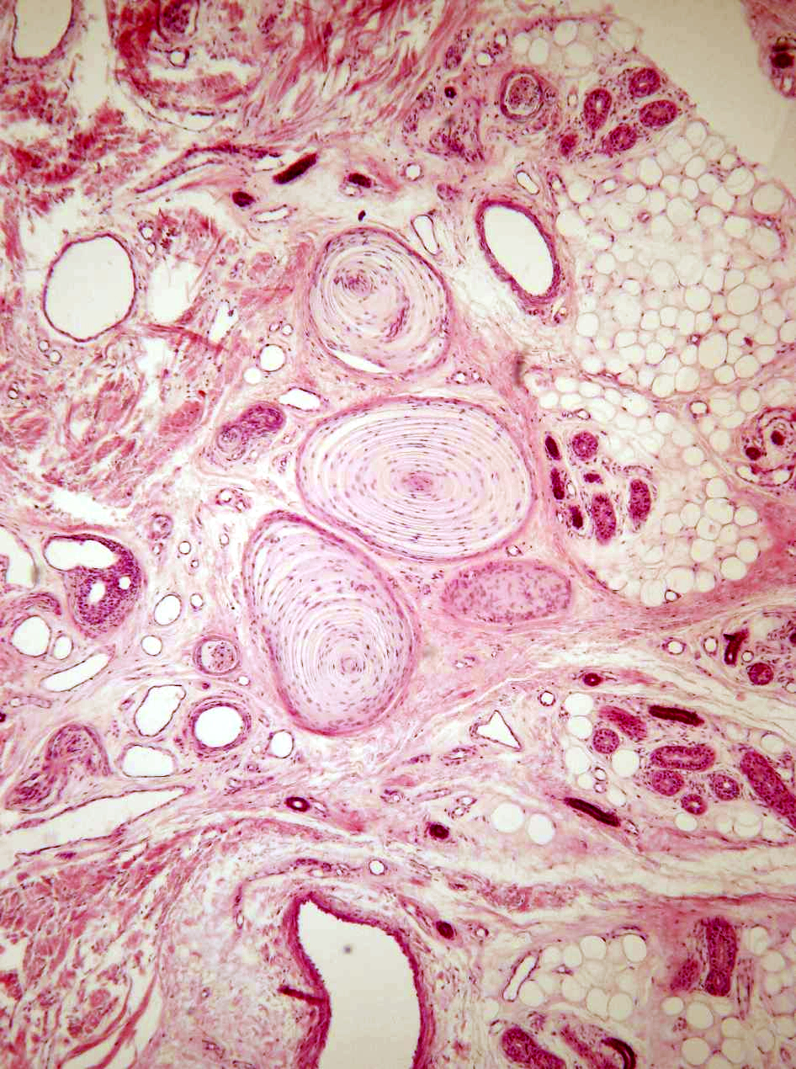
1) What is NOT
depicted in this
image?
a) sweat gland ducts
b) pacinian corpuscles
c) dermis
d) Meissner’s corpuscles
e) sweat gland secretory
units

Slide 12
2) What can be described by all three of the following characteristics:
-stratified cuboidal epithelium
-sodium resorption
-location in dermis and epidermis
a) apocrine sweat glands
b) eccrine gland secretory portions
c) eccrine gland ducts
d) sebaceous gland ducts
e) hair follicles

Slide 13
During class…
e-Syllabus, TUSK
iMCQ
iReview
-class divided into thirds; each group remained constant but the
three faculty rotated (thus 7-8 sessions with a given 65-student group)
-12 MCQs, alternating text/image questions, 2 min/question
(students did NOT have prior access to the questions – but
these (with answers) are posted after class)
-small groups (usually 2-3 students) discuss each question
and distractors for 2 minutes and arrive at an answer
-one group presents their decision & rationale
-open discussion to ensure all are in agreement about the
correct answer and rationale
-move on to next question
(this portion of the class lasts ~1 hour)

Slide 14
During class…
e-Syllabus, TUSK
iMCQ
iReview
-instructor-led presentation reviewing important concepts (this PPT “lecture” IS made available to the students prior to class)
-open for discussion and questions*
-students should leave feeling comfortable with topic and satisfied that all their questions have been answered
(this portion of the class lasts ~1/2 hour)
[Full-class lecture reviews were given (and recorded) prior to each exam - five reviews in total]
*these were more numerous than in
a typical lecture

Slide 15
-Interactive sessions were NOT recorded:
-the real benefit from this approach lies in the student interaction
as they actively discuss and debate the answers.
-with recordings, all learning would be passive (and attendance
would have dropped; students would just memorize questions/
answers)
-In lecture format courses, recordings make sense:
-lectures are rarely interactive so listening via a recording is
nearly equivalent to live (and has some benefits such as convenience,
pause and speed control)

Slide 16
What we have observed:
-students remain engaged for the full 1.5 hours:
-minimal off-topic discussions
-spend time discussing or looking up information
-no emailing, texting, ordering from Amazon, etc.
-keeping them busy keeps them engaged (exam-type
questions really get their attention)
-when engaged, they ask questions continuously following
the MCQ’s and during the iReview presentation
-in large rooms, the students often sit in the front!
-some students must be preparing well - they answer the
questions correctly and can explain their reasoning
-some students insist on a printed syllabus and take the time to
take snap-shots of all images and then print both text & images

Slide 17
-significant variability in attendance – probably relating to
other course work
-incorporating a few questions in lecture courses should help engage
(or re-engage) the students [they’re getting used to discussing
questions]. Good questions are essential.
As faculty:
-interactive class preparation is very time consuming (much more
than with lecture formats)
-all faculty must be well-versed in all topics (assuming a team-taught
course)
-classrooms are much more dynamic than the relatively static
lectures

Slide 18
Student evaluations
faculty as facilitator & lecturer – 4.58/4.56/3.38
course directors 4.46/4.51
course objectives met – 4.11
lecture review sessions – 4.62
overall course rating – 3.71
e-syllabus – 2.94
virtual microscope – 3.6
interactive classrooms – 3.48

Slide 19
Student evaluations
Interactive classes
The quizzes and participatory nature encouraged more preparation before lecture, and the material was then reinforced during class, which allowed me to leave lecture with a good grasp of material and spend less time studying later on.
Loved the interactive classroom - helped you LEARN in class rather than just listen
I thought these were very helpful for learning. However, to adequately prepare was extremely time consuming. I would not be able to handle a second course of this sort effectively at the same time. I learned a lot, and what I learned stuck with me and I hardly had to study at all for the exams. I really liked them a lot.
It is hard to only have one class in this format, and adjust to the different study habits needed. Once I did adjust, I liked this format. I think it would be helpful to have one or two more summary lectures in each section to solidify the material.
While it took adjusting, I think I learned the material very well, and I also learned how to adapt to a new teaching style.
I believe the interactive classroom was a STRENGTH of this course. It required more preparation for each class, making any more than 4 histo session per week unmanageable, but it made studying for the exams easier.
I thought that the interactive classroom really forced me to stay on top of the material and use the class time to reinforce my knowledge.

Slide 20
I really believe that more teaching has to happen in this course. The knowledge, experience, explanations of a professor can not be replaced by a website. The syllabus did not adequately prepare one for the interactive classroom quizzes or the test. Although I do like the idea of the quizzes I think there should be an hour long teaching period followed by a half-hour quiz. The current set-up just seems backwards to me.
I did not go to them as I did not find them very helpful. 1.5 hours to answer 12 questions was not a useful way to spend my time
A return to didactic lecturing would help greatly. IC are a valiant experiment, but I believe lecturing is better suited to this course.
I was a former MBS student who took this class before and did very well. It was one of my favorite classes. But, the way it was taught this year was not conducive at all to the way I learn and many of my classmates echoed my sentiments.
I didn't find the interactive classroom sessions helpful (at all) until I started watching last years lectures before I went. I started out struggling through the syllabus and going through the photos but when I went to interactive classroom I was just confused and didn't learn anything. When I started watching last years lectures the night before our interactive classrooms - it was a eureka moment. All of a sudden I could answer the questions, I understood what to look for, how to think about the slides, etc. Don't get rid of these! For kids who learn better from a taught format, they are an invaluable resource - it cut the amount of time I needed to study in half and got me to 50x the level of understanding. The interactive classroom alone doesn't seem effective (I was failing). When it is offered in combination with these lectures - I think it is probably the best class format we've got. You are taught on your own via a recorded lecture, then you go in and test what you've learned in an interactive classroom.

Slide 21
Student evaluations
e-syllabus:
The E syllabus was very, very useful. I liked the organization and the format. Some technical difficulties here and there, but for the most part well done.
Some people are going to say the eSyllabus is terrible; I would prefer that it remain, both because I think it is more environmentally conscious and because I think it is a perfectly effective tool that simply requires some getting used to. Certainly there are kinks to be worked out (mouse-over definitions, disparities between Mac and PC displays), but in general I think it's a good idea.
I used it a ton. I thought it was great. It would be SO much greater if the links were all embedded in the page. Also there was redundancy in some of them - this could definitely be improved.
Amazing resource. I learned a lot from the eSyllabus. The only issue that I have is with the image links. I have a desktop with two screens, so I was very fortunate - I could just open the images on a separate screen, and the experience was very smooth. Whenever I was studying on my laptop, however, I realized that it is very inconvenient to have to go back and forth, and that the images open on a new page. If there was a way to embed the images in the eSyllabus, it would make the experience a lot smoother.

Slide 22
Student evaluations
e-syllabus:
It was often annoying to navigate around the e-syllabus. The website was not responsive enough (I often would make my window smaller, so I could take notes at the same time that I read it, and half of the page's text would be cut off). Also, after clicking a link and then going back to the e-syllabus, I would often have to scroll to find where I was on the page. I often gave up on the e-syllabus half way through reading it, because the formatting was so annoying.
Very difficult to navigate, would have been better without links (just add pictures and text into the main body of the syllabus).
I would have preferred a printed version of the information (with maybe an online virtual microscope component).
The usability of the eSyllabus was quite poor and made learning/reviewing the material quite inefficient. I survived off of the previous year's recorded lectures and then used the eSyllabus as supporting material.
Information nested within links made information difficult to find, especially when reviewing or studying

Slide 23
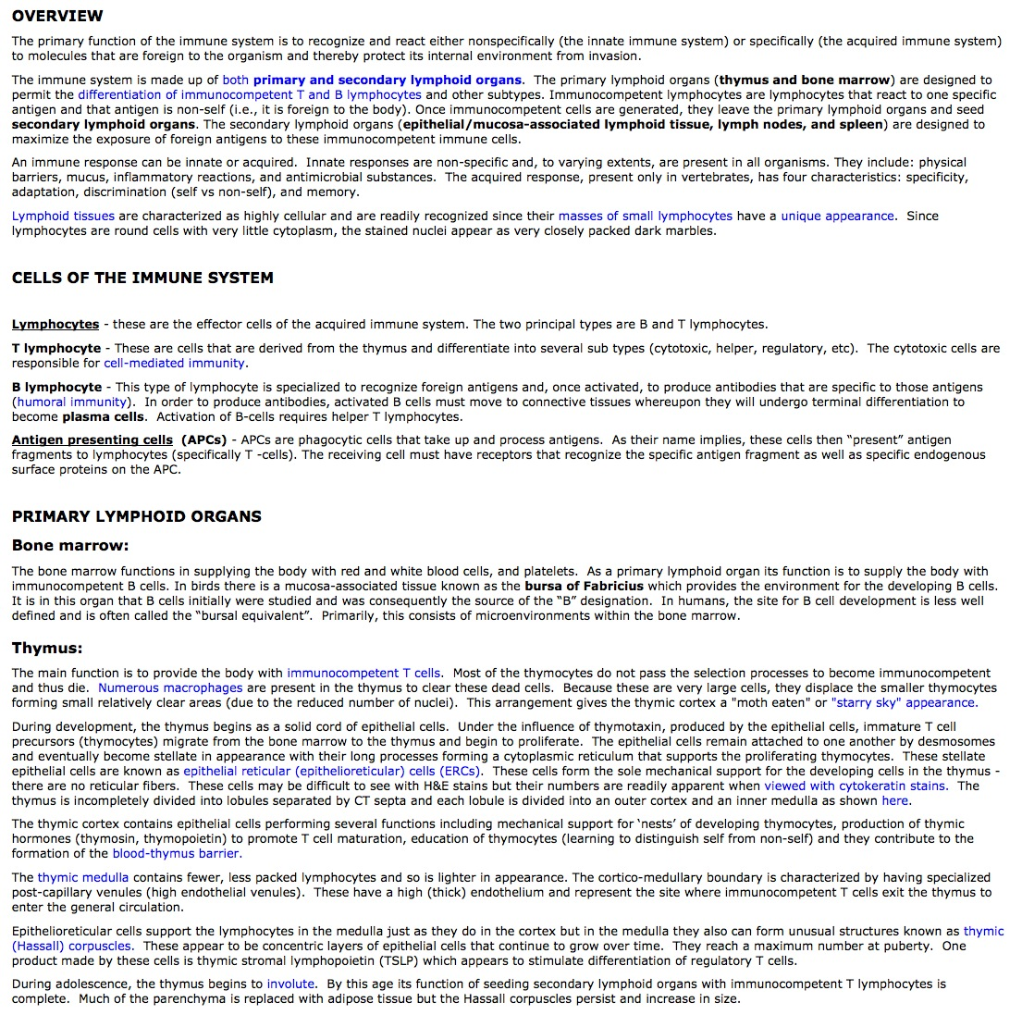
e-syllabus:

Slide 24
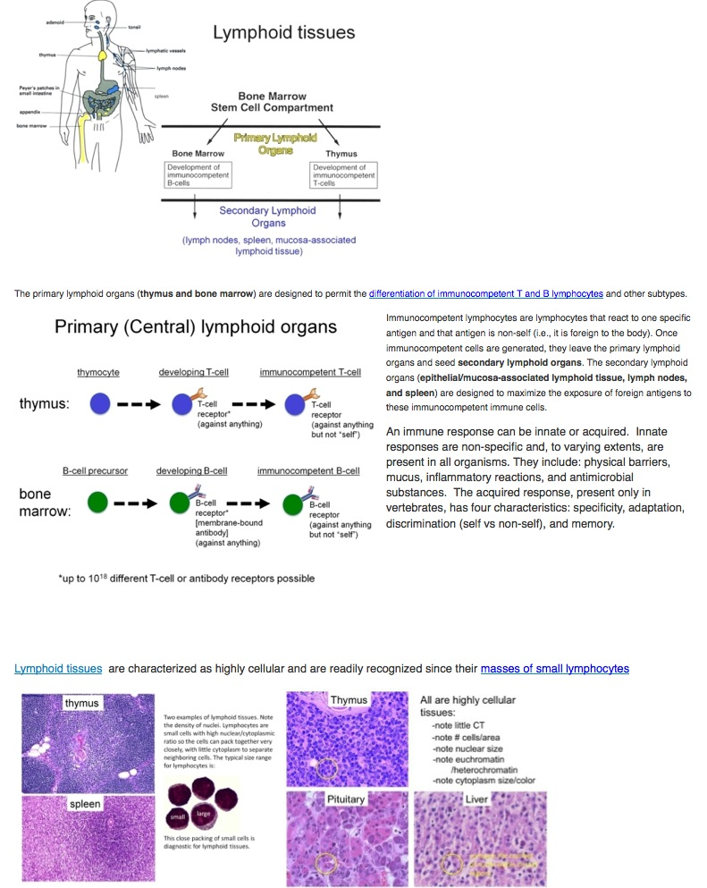
-alternatively, we may be able to have the links appear as thumbnails; hovering would then enlarge them to full size
-other e-syllabus changes we plan to make:
-adding hover definitions for words every time they appear in the text (could be colored)

Slide 25
Student evaluations
Virtual Microscope
Loved this. Helped you see all the elements of an organ/system/etc. in one window. I wish the zoom on the exams was as clear as the zoom on the virtual microscope. You couldn't zoom the images on the exams without losing focus.
More virtual microscopes would have been helpful. Even different pictures of the same thing is helpful.
Fantastic idea. I really hope that the course directors continue it and improve on it. It would be nice to see virtual microscope used for more courses - hope that pathology uses it!
I thought this was a good resource and it was helpful to try to pick out images of structures or cells that were discussed in the syllabus.

Slide 26
Student evaluations
Virtual Microscope
It almost never worked on my computer. Either the images didn't load or they were hard to make out.
It was so difficult to move around. I would rather the professor walk us through it on the big screen.
This was kind of cool, but having it embedded in the esyllabus was a big problem. It meant that it took forever for my page to load, and every time I clicked on a link and then went back, the page would automatically reload to the virtual microscope, which was super frustrating.
The virtual microscope was also very cumbersome. I did not use it as it was difficult to navigate. The reward I got from it was certainly not worth the trouble it took to use.

Slide 27
Student evaluations
Other comments
-students want the MCQs ahead of class (for note-taking)
-upload to TUSK just prior to class??
-what about those who want time to print them??
-students want all the sessions recorded
-will consider for iReview sessions next year
-students comment (negatively) on the variability between faculty
(this is always an issue with team-taught courses, even with lectures)

Slide 28
Summary
-overall the students had a mixed view of the new format and had
specific requests:
-recording of IC sessions
-providing lecture recordings prior to class:
-prepare many short recordings as initially planned (100+)
-or, record one lecture for each topic (one lecturer)
-switch the order: interactive review followed by the MCQs
-remove hyperlinks in e-syllabus
-remove e-syllabus content that is not reviewed in class
-separate virtual microscope from syllabus
-on exams, the students did as well as in past years (that had lecture
format)
-for faculty, switching from lecture to interactive format is very time
consuming but the interactive classroom experience is much more
rewarding than is lecturing to a mostly passive audience

Slide 29
Challenges
-How to get the students to attend classes? The real benefit of
this format requires active participation.
-giving points for attendance is not an option (Curriculum
Committee vote)
-points deduction for not attending is an option but not ideal
-providing lectures for pre-class studying seems necessary
but students may then not attend classes
-How to encourage more discussion?
-pre-assign small groups and give each flash cards (A-E) that
they must flash with their answer (forcing them to commit)
-use peer review system within assigned groups
-use a series of lectures followed by small group interactive
MCQ sessions (students should be better prepared)

