Slide 1
Retrofitting STEM Courses for Increased Inclusion
Erica Kemmerling
Tufts Teaching Conference
May 20th, 2025

Slide 2
The Need for Inclusion
Traditional STEM education techniques are aimed at straight, white, neurotypical, able-bodied men
We must update our methods so students of all identities are welcomed and taught well
Inclusive teaching benefits EVERYONE (not just marginalized students)
Notes:
Why inclusive teaching benefits everyone: Prepares students to work in environments with diversity
Develops empathy
Helps students notice and fight inequity

Slide 3
Why STEM Educators Don’t Use Research on Inclusive Teaching
Education papers are difficult to read/understand
Many publications focus on problems, not solutions
Many suggested strategies require time-consuming course overhauls
No incentives from higher ed employers

Slide 4
The STEM Inclusive Teaching Guide
Goal: make higher ed STEM classes more inclusive via low-hanging fruit methods
List of practical, actionable inclusive STEM teaching strategies backed up by research
Focus on low-time-commitment course retrofits
Geared towards busy instructors with no education research background
NOT a guide to becoming anti-racist

Slide 5
Organization of STEM Inclusive Teaching Guide
Recommendations grouped by course component
Lectures
Homework
Group work/projects
Assessments
Informal student/instructor interactions
Classroom culture
Recommendations listed with estimated prep time and class time commitments
Lots of citations and suggestions for further reading

Slide 6
Students Who Are Particularly Vulnerable in 2025
Neurodiverse
Anxious
Short attention span
Economically disadvantaged
Marginalized by current political climate
International students
People of color
Marginalized genders

Slide 7
Sample Recommendations: Supporting Neurodiverse Students
Recommendation | Required Prep Time | Required Class Time
Reduce the grade impact of traditional tests and/or spread out the grade over different types of assessments. [5,6] | none | none
Create a range of ways for students to participate– both verbal and non- verbal, synchronous and asynchronous. [7, 8] | 5-10 min per activity | none
Relevant Learning Sciences Principles: Cognitive overload reduction [1] , dual coding [2]

Slide 8
Sample Recommendations: Supporting Economically Disadvantaged Students
Recommendation | Required Prep Time | Required Class Time
Try to use Open Educational Resources (OER) when possible to contain costs for students. | varies | none
Stagger office hour scheduling to accommodate students who may have work outside of class hours. | none | none

Slide 9
Sample Recommendations: Supporting International Students
Recommendation | Required Prep Time | Required Class Time
Give students opportunities to reflect on their successes and challenges in class and how they might be connected to their academic background and prior knowledge [4] | none | 5 min per reflection
If using cultural references in class examples, choose situations and terminology that will be familiar to everyone (e.g. “car” = good, “slip-n-slide” = bad) | 5-30 min per example | none
Relevant Learning Sciences Principles: Metacognition (supporting student awareness of their own learning) [1]
Notes:
Metacognition helps students identify areas in which their academic background prepared them differently and thus where they need to seek help

Slide 10
Sample Recommendations: Supporting Students of Marginalized Race and Gender
Recommendation | Required Prep Time | Required Class Time
Create teams with at least two members of a particular historically marginalized group (for example, at least two black students in the same group). [10, 11–13] | varies, but low | none
Add a list of campus resources (including community centers for historically marginalized groups, mental health services, etc.) to the syllabus. [9] | 30-60 minutes | none
Relevant Learning Sciences Principle: Stereotype threat reduction [3]

Slide 11
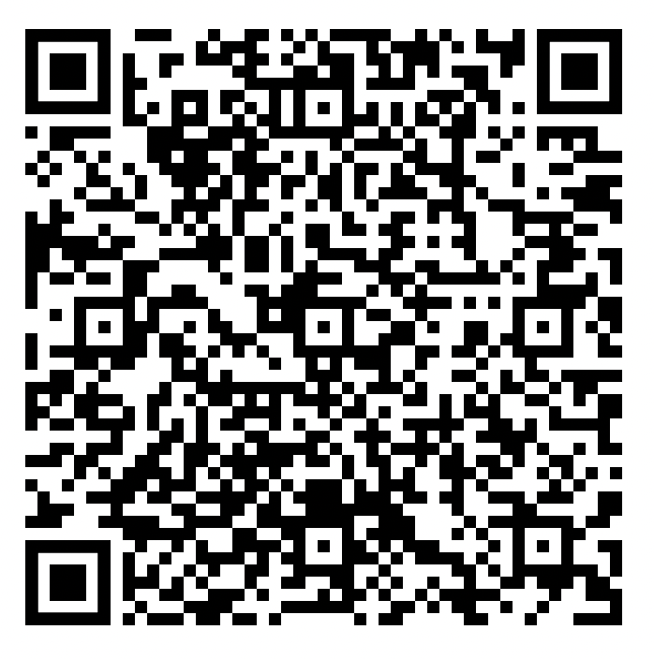
Questions?
Link and QR Code for STEM Inclusive Teaching Manual:
https://www.dropbox.com/scl/fi/s02g90fvhqsovb2sr1bk4/STEMInclusiveTeachingManual2024.pdf?rlkey=napoc8sgz9wl4kfoelbpjhodb&dl=0

Slide 12
Sources
P. K. Agarwal and P. M. Bain, Powerful Teaching: Unleash the Science of Learning. San Francisco, CA: Jossy-Bass, 2019.
M. Sumeracki, C. Nebel, C. Kuepper-Tetzel, and A. N. Kaminske, “Weekly Digest #67: Dual Coding in the Classroom,” https://www.learningscientists.org/ [Online]. Available: https://www.learningscientists.org/blog/2017/7/9/weekly-digest-67. [Accessed May 19, 2025].
J. Johns, M. Inzlicht, and T. Schmader, “Stereotype threat and executive resource depletion: Examining the influence of emotion regulation,” Journal of Experimental Psychology: General, vol. 137, pp. 691–705, 2008.
J. L. Hsu and G. R. Goldsmith, “Instructor strategies to alleviate stress and anxiety among college and university stem students,” CBE–Life Sciences, vol. 20, pp. 1–13, 2021.
P. Black, C. Harrison, C. Lee, B. Marshall, and D. William, “Working inside the black box: Assessment for learning in the classroom,” Phi Delta Kappan, vol. 86, no. 1, pp. 8–21, 2004.
G. D. Kuh, S. O. Ikenberry, N. A. Jankowsky, T. R. Cain, P. T. Ewell, P. Hutchings, and J. Kinzie, Using evidence of student learning to improve higher education. Jossey-Bass, 2015.
T.Zakrajsek,“Students who don’t participate in class discussions: They are not all introverts.”Online, 2017. https://www.scholarlyteacher.com/post/students-who-dont-participate-in-class-discussions.
R. D. Robnett, C. J. Ballen, S. Fagbodun, K. Lane, S. J. McCoy, L. Robinson, E. I. Weems, and S. Cotner, “Are synchronous chats a silver lining of emergency remote instruction? text-based chatting is disproportionately favored by women in a non-major introductory biology course,” PLOS ONE, vol. 17, no. 10, pp. 1–15, 2022.
U. of Michigan Center for Research on Learning and T. (CRLT), “Inclusive teaching strategy inventory.” Online, 2020. https://sites.lsa.umich.edu/inclusive-teaching/inventory-of-inclusive-teaching- strategies/.
A. T. Miller, “The multicultural lab: Diversity issues in stem classes,” in Teaching Inclusively: Resources for Course, Department, and Institutional Change in Higher Education (M. Ouellett, ed.), New Forums Press, 2005.
C. J. Finelli, I. Bergom, and V. Mesa, “Student teams in the engineering classroom and beyond: Setting students up for success.” Online, 2011. Occasional Paper #29 from University of Michigan Center for Research on Learning and Teaching.
S. Ingram and A. Parker, “Gender and modes of collaboration in an engineering classroom: A profile of two women on student teams,” Journal of Business and Technical Communication, vol. 16, no. 1, pp. 33–68, 2002.
L. K. Michaelsen and M. Sweet, “The essential elements of team-based learning,” in Team-based learning: Small group learning’s next big step: New directions for teaching and learning (L. K. Michaelsen, M. Sweet, and D. X. Parmelee, eds.), Jossey-Bass, 2008.

